Slide 1
Welcome, Aviation & Travel Enthusiastic! Today’s Topic: Trends in the Aviation and Tourism Industry
Fachbereich 3 Wirtschaft und Recht
Prof. Dr. Karl-Rudolf Rupprecht, 10.09.2021

Slide 2
Our challenge: Covid Monthly passenger at busiest European airport LHR
07/2019
07/2020
07/2021
7.754.139 passengers
866.655 passengers
1.510.845 passengers
≈ 250.000 passengers
Source: Heathrow Monthly Traffic Statistics

Slide 3
Recovery of global air travel and consumer confidence
Slow recovery of global air travel since May-20
Revenue Passenger Kilometers (RPKs) still 63% down compared to pre-crisis level (May-19)
Consumer confidence key for the recovery
Source: IATA Economics using data from IATA Statistics and Refinitiv Eikon Datastream

Slide 4
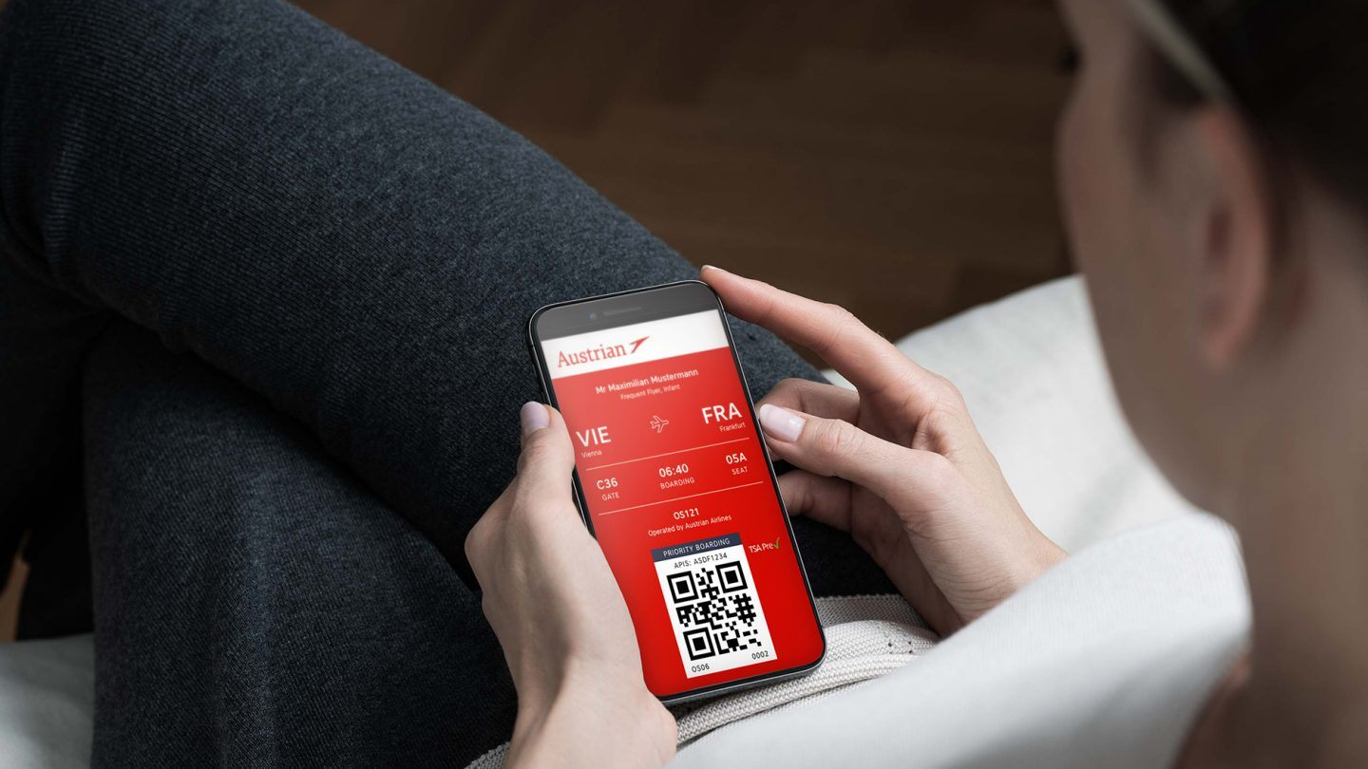
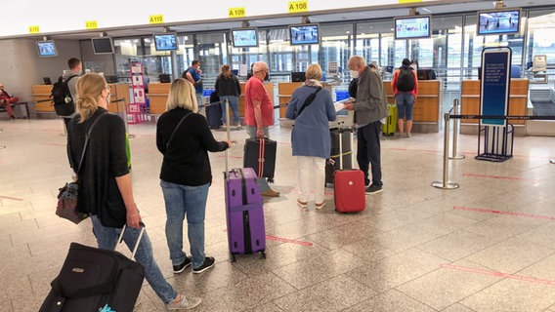
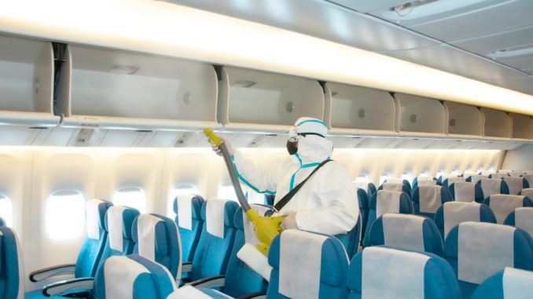
Restoring of consumer confidence along the journey
Prior-flight processes as many as possible from home
Time at the airport
as short and safe as possible
Aircraft
as clean as possible
Danger for cyber security?
What about airport retail?
Who covers additional costs?
Short-term measures or sustainable adaptions?

Slide 5
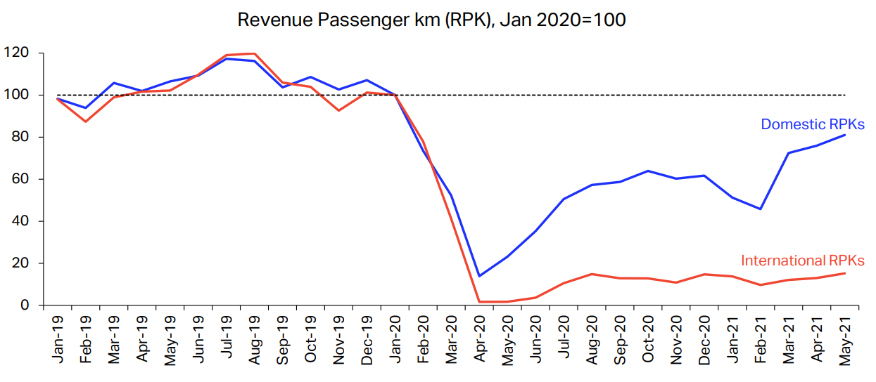
Travel recovery diverges between markets Focus 1: Domestic vs. international air traffic
Strong domestic recovery (76% vs. May-19)
Weak international recovery (15% vs. May-19)
Rebound of international bookings due to holiday season
Source: IATA Economics using data from IATA Statistics

Slide 6
Travel recovery diverges between markets Focus 2: Differences in national virus control
Domestic air travel in Russia and China recovered above pre-crisis levels
US on track
Brazil and India performing below global average
23%
26%
6%
71%
44%
Source: IATA Economics using data from IATA Monthly Statistics

Slide 7
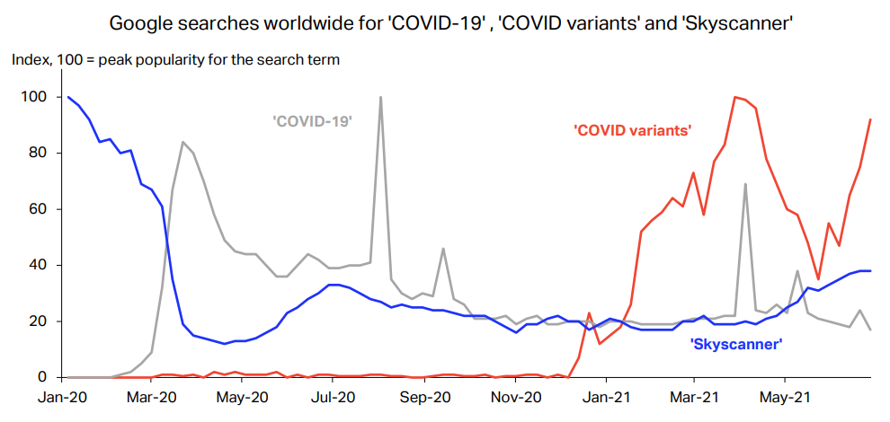
People want to travel but are afraid of COVID variants
Based on google searches, there is increased interest for booking flights
Main concern is new covid-19 variants
They could cause a delay in the opening of some markets
Source: IATA Economics using Google Trends, search period between 1.1.2019-30.6.2021

Slide 8
Let’s continue to have “optimism with caution”
- an expression used by IATA Senior Economist Ezgi Gulbas
End of cheap flying
Reduction of
business trips
Trends after the pandemic Do you agree?
End of overcapacities
Strong focus of clean and sustainable air travel
Continuing
consolidation of airlines
Let‘s look at some measures for carbon neutral-air transport
(Master Plan Bundesverband der Deutschen Luftverkehrswirtschaft)

Slide 9
All industry partners are involved in climate protection
Airline
Modernization of fleets with lower emission aircraft
→ Reduction of carbon emissions p.a. by 1,5%
Airport
Implementation of carbon-neutral airport operation
→ Green Airport Strategy
Side effect
Involvement in climate protection strengthens collaboration between partners
Air Traffic Control More efficient air traffic control in the Single European Sky → Direct routing and continuous descent of aircraft

Slide 10
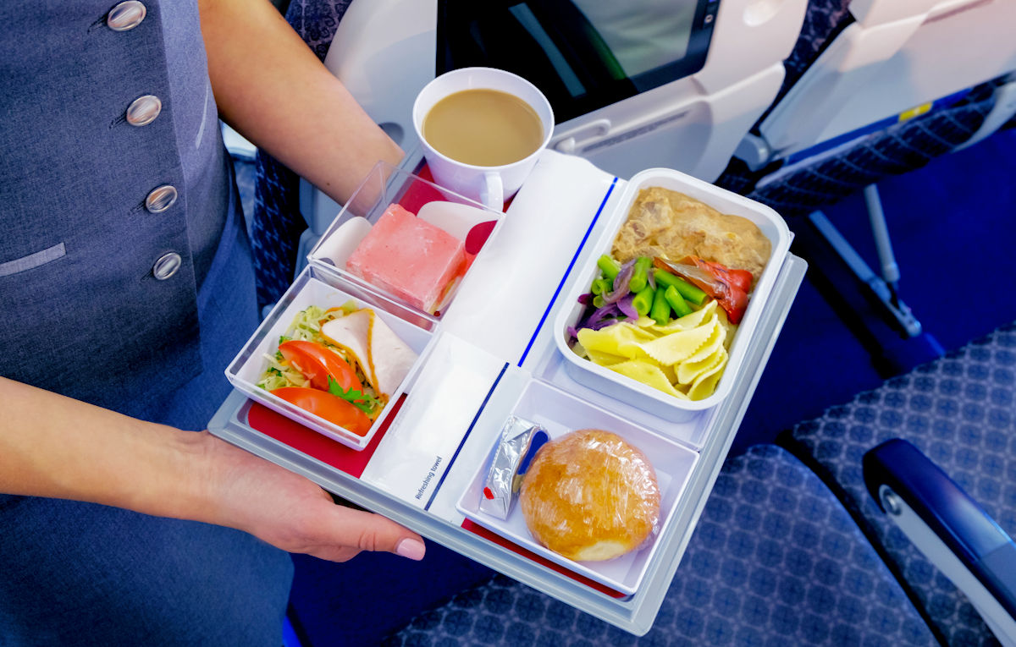
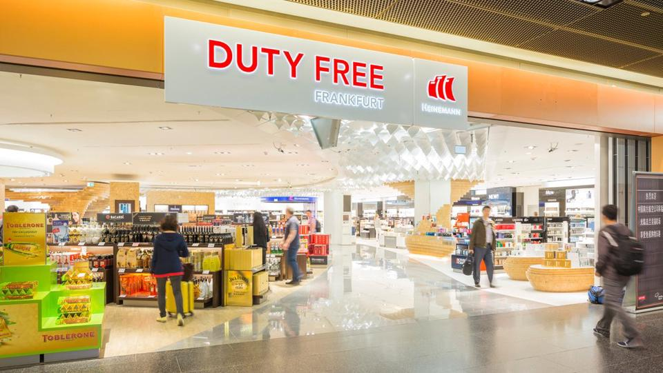
Responsibilities along the entire travel experience
Intermodality
Green Tourism
UN Sustainable Development Goals
Catering
Retail
Transfer of air traffic on ultra short-haul distances to rail
Carbon-neutral retail
Plastic reduction

Slide 11
Greenhouse Gas Emissions can be offset, a good idea?
Airlines buy or receive certificates with emissions allowances, which they can trade among each other
Global level (ICAO): CORSIA
Carbon Offsetting and Reduction Scheme for International Aviation
European level (EU): EU ETS
EU Emissions Trading System
1/3 CO₂ Emissions
x
2/3 Non-CO₂ Emissions

Slide 12
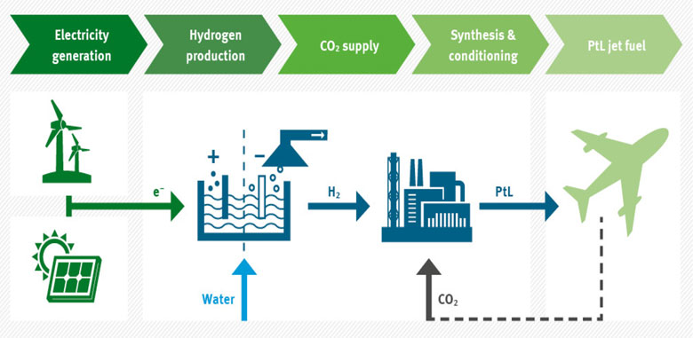
Replacement of fossil kerosene is challenging
Power to Liquid (PtL) - a Sustainable Aviation Fuel
Challenges
Storage of electricity
Storage of hydrogen
Availability of CO₂ in useful quantity, concentration and purity
Industrial production (scalability)
Price (factor 3-5 compared to fossil kerosene)
Source: Magazin für Wasserstoff und Brennstoffzellen

Slide 13
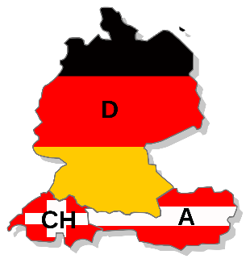
Future challenges demand partnership& action Start now: Example Amadeus Executive Round Table
Reise-ver-band
DRV, VIR, VDR
Frankfurt University of Applied Sciences,
Universität St. Gallen
Hoch-schule
Airline
Lufthansa, Barig e.V., Star Alliance
Dienst-leister
Airport
Stuttgart Airport / ADV, BDL, Fraport AG, Flughafen Wien, Flughafen Zürich
Verimi, Centogene AG, Vitolus, The Commons Project
Politik
Hotel
BWH Hotel Group
BMVI, BMWi
Desti-nation Marke-ting
Mobili-tät
Deutsche Bahn Vertrieb GmbH,
Europcar Mobility Group,
Flixmobility GmbH
DZT, GCB
Reise-büro
Medien & Events
DER Touristik GmbH, flyla GmbH, (Online Studentenreisebüro DACH)
XSP Kommunikation GmbH, ITB Berlin Kongress

Slide 14
Ready for Take-Off
Fachbereich 3 Wirtschaft und Recht

