Slide 1
VALUE PROPOSITION CANVAS
  VPC

Slide 2

The Value Proposition Canvas

Slide 3
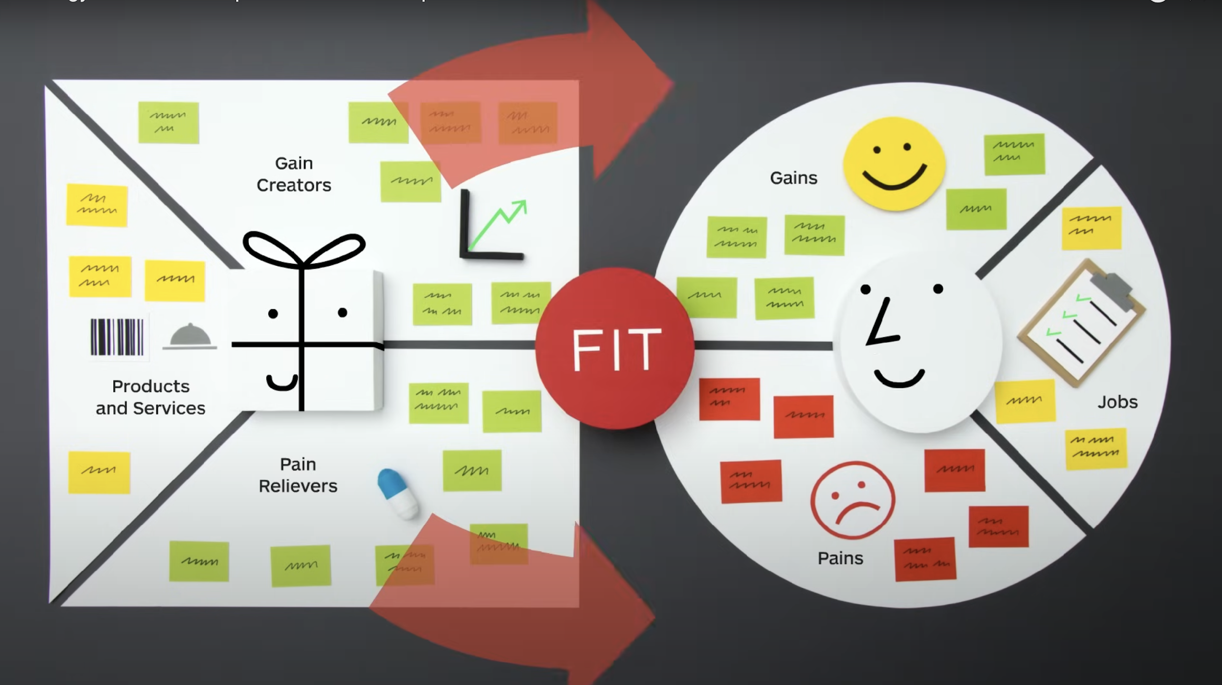
The Value Proposition Canvas
Value Proposition Canvas
Value Proposition Canvas is a tool for marketing experts, product owners, and value creators. This method from the bestselling innovation book Value Proposition Design is applied in leading organizations and start-ups worldwide.
Why use the Value Proposition Canvas?
Precisely define your customer profiles
Identify your customer's major Jobs-to-be-done, the pains they face when trying to accomplish their Jobs-to-be-done and the gains they perceive by getting their jobs done.
Visualize the value you create
Define the most important components of your offering, how you relieve pain and create gains for your customers.
Achieve product-market fit
Adjust your Value Proposition based on the insights you gained from customer evidence and achieve Product-Market fit.
Source: https://www.strategyzer.com/library/the-value-proposition-canvas

Slide 4
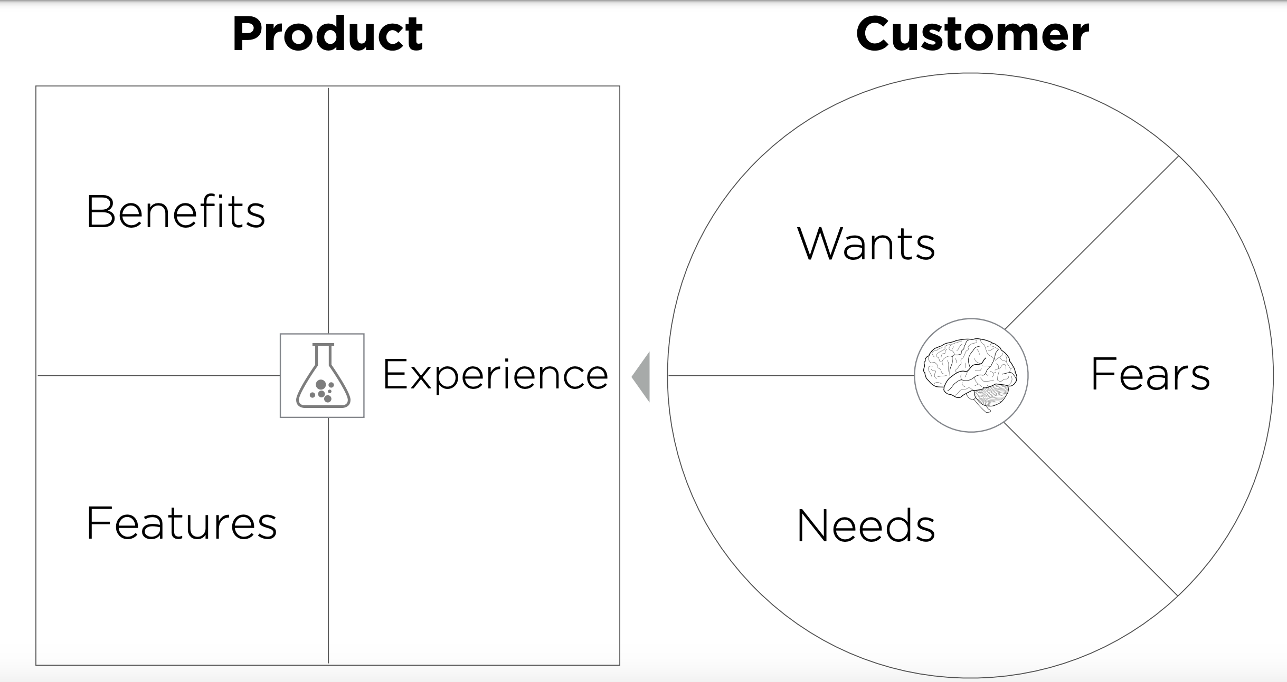
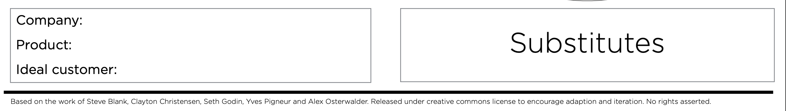
Add your points to sticky notes and add them to the product/customer
Sticky Note
Sticky Note
Sticky Note
Sticky Note
Sticky Note
Sticky Note
Sticky Note
Sticky Note
Sticky Note
Sticky Note

Slide 5
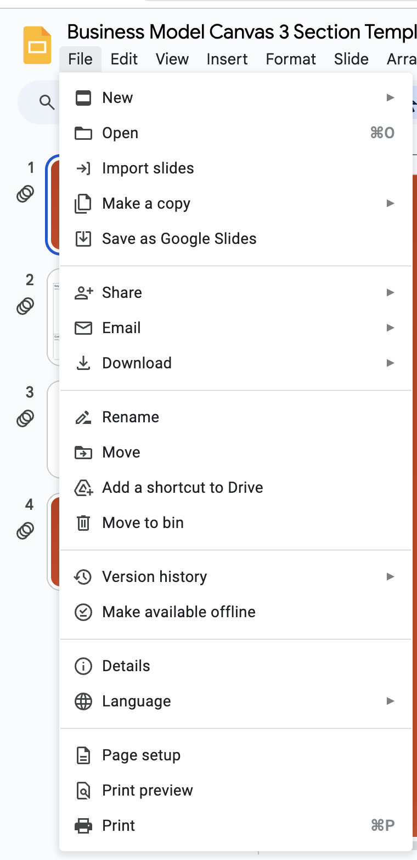
You can click file:
Download the PowerPoint and fill in
Forward your file to michael.Keaney@metropolia.fi

Slide 6
VALUE PROPOSITION CANVAS
  VPC

