Slide 1
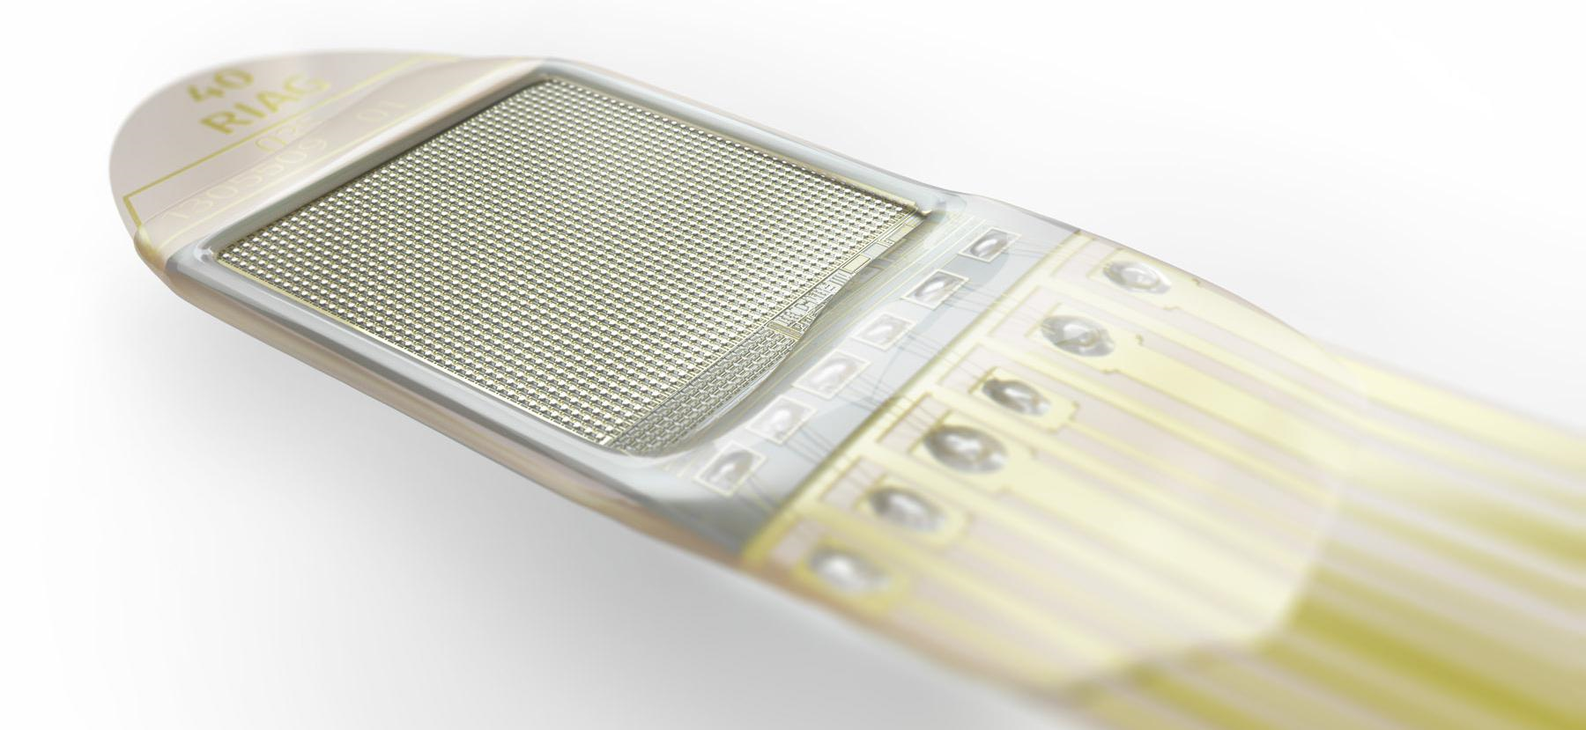
Seeing with an implant - how a microprocessor in the retina works -

Slide 2
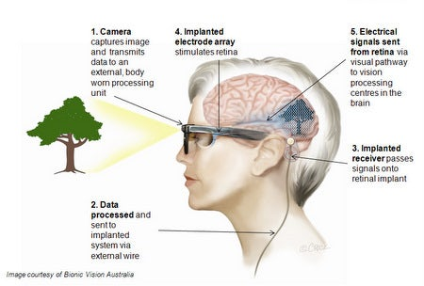
Like a camera in your eye
The sub-retinal implant contains a microchip, similar to a digital camera, which is implanted under the retina.

Slide 3
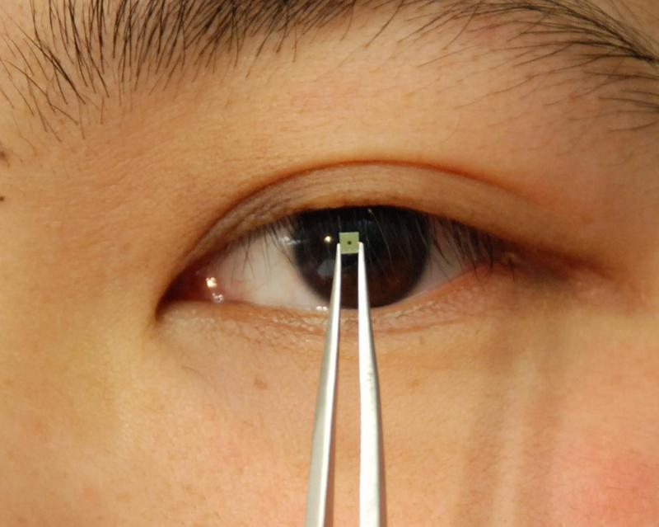
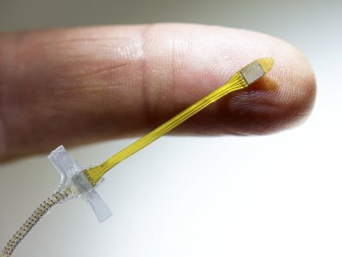
One implant, three components:
The chip is only 4 mm in size with a height of approx. 70 µm. It is equipped with 1600 photodiodes, which convert the incident light into an electrical signal.

Slide 4
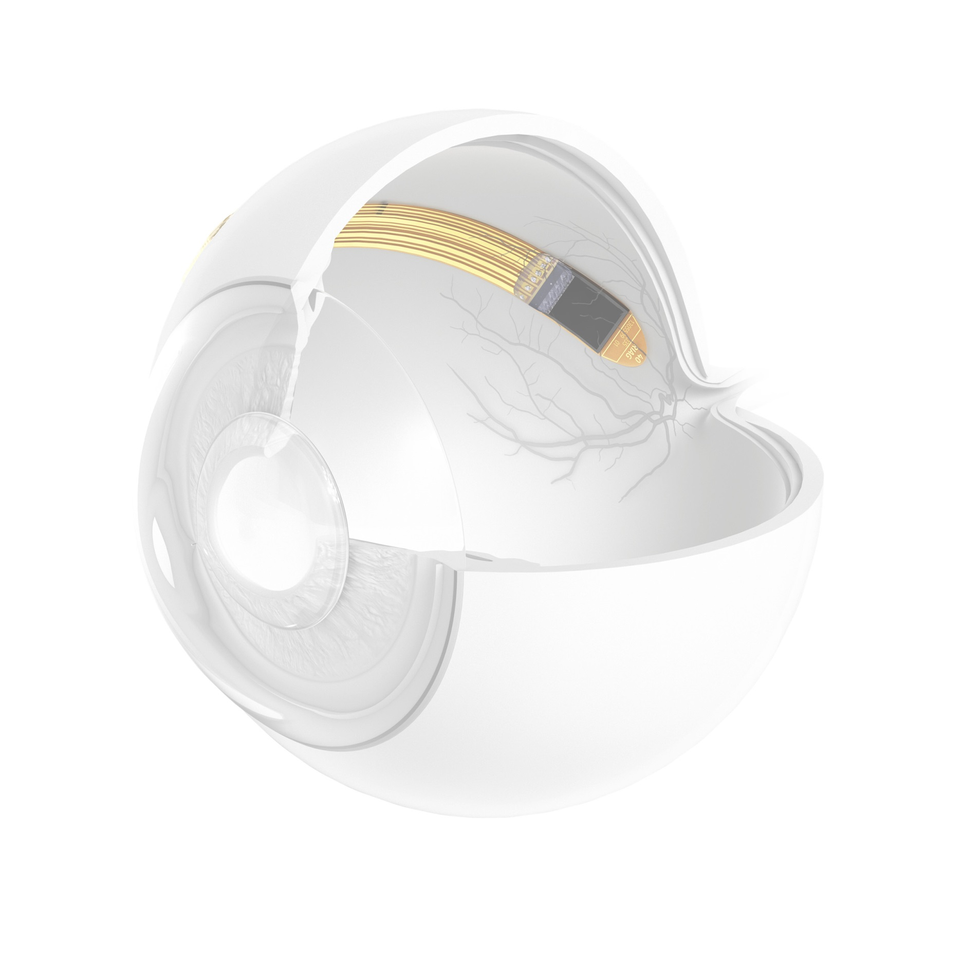
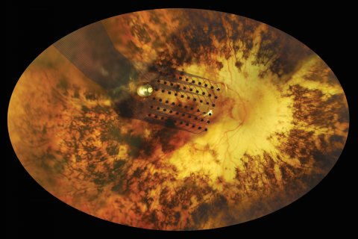
Argus-ii-retinal-implant
Electrodes implanted onto the retina

Slide 5
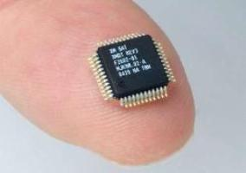
The receiver
The portion of the RETINA IMPLANT implanted in the eye does not have batteries or other power sources.

Slide 6
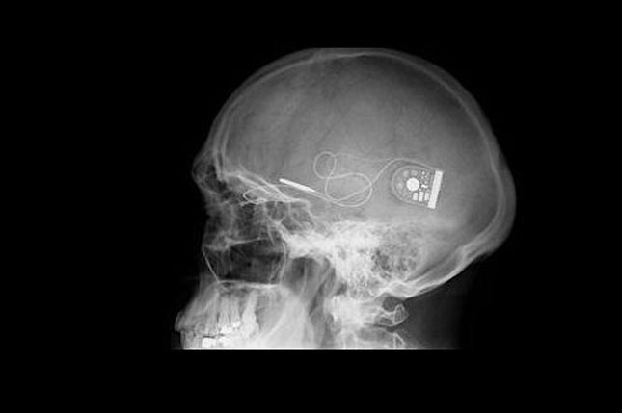
Receiver of the implant

Slide 7
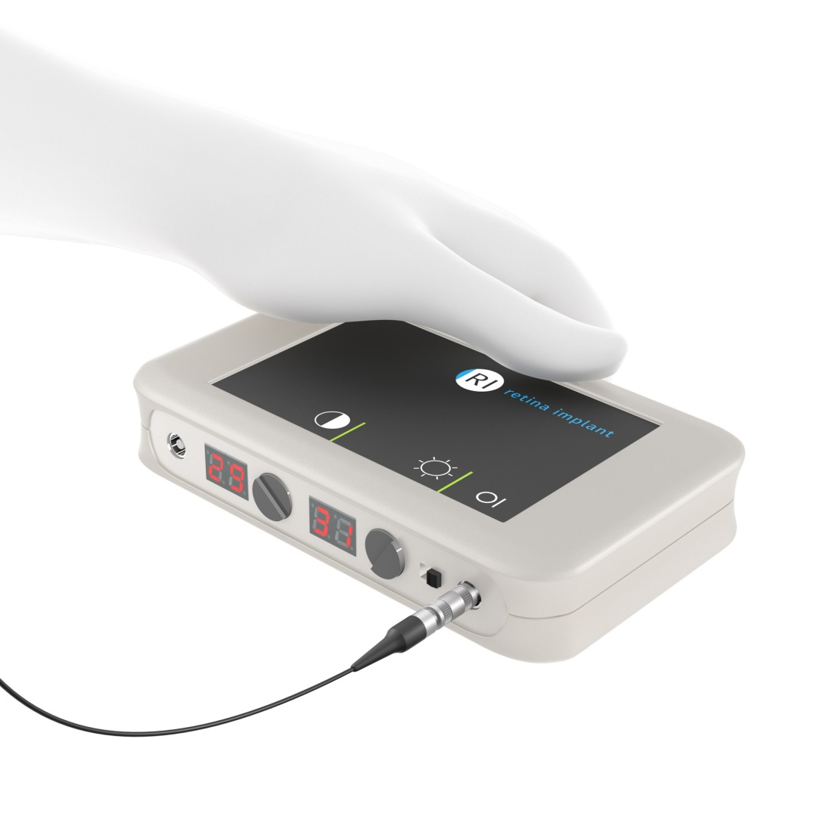
The control unit
The transponder sends the energy from the handheld device from the outside via magnetic induction to the implanted coil.

Slide 8
Results in visual function
Due to the technical characteristics of the RETINA IMPLANT a theoretical maximum visual acuity of 0.07 (“7%”) with a horizontal visual field of 13° is possible.
The best visual acuity achieved so far has been 0.037 (“3,7%).

Slide 9
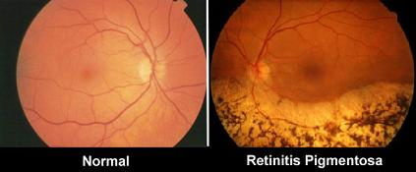
Who is the implant suitable for?
These symptoms are mostly associated with an eye disease called “retinitis pigmentosa” (RP).

Slide 10
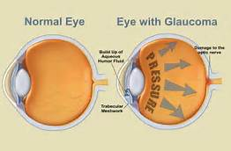
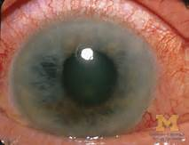
The RETINA IMPLANT is not suited for...
Glaucoma / elevated intraocular pressure
Congenital blindness
Retinal circulatory disorders
Blindness caused by stroke
Changes in the retina due to diabetes
Optic nerve diseases / optic atrophy
Age-related macular degeneration (AMD)

Slide 11
Thank you for your attention!

Slide 12
Source
http://www.improveeyesighthq.com/retinitis-pigmentosa.html
http://www.iricss.org/fa/NewsRelease/News/Pages/890817_Vision_Chip.aspx
http://www.businessinsider.com/scientists-put-a-bionic-eye-to-the-test-and-it-helped-blind-people-see-again-2015-7?IR=T
https://www.retina-implant.de/

