Slide 1
Trends in Airline & Aviation, Transportation, Travel & Hospitality Let‘s have a look into the future
Fachbereich 3 Wirtschaft und Recht
Prof. Dr. Karl-Rudolf Rupprecht | September 2022 | Intro Winter Semester 2022/2023

Slide 2
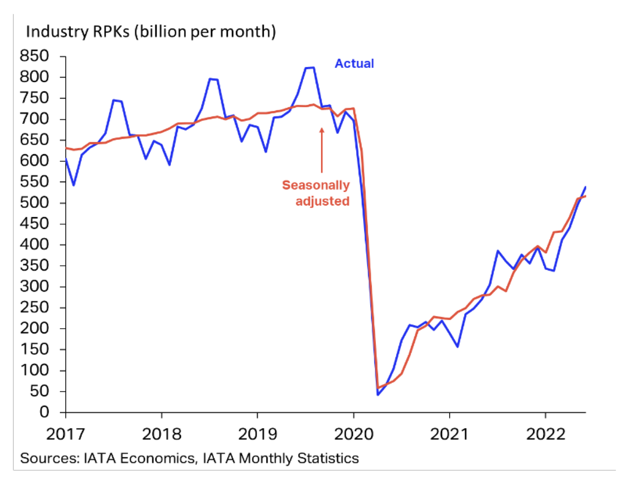
Recovery of air traffic allows us to discuss future trends
Industry-wide revenue passenger- kilometers (RPKs) have risen to 71% of 2019 levels
Domestic and international passenger load factor above 80%
Re-opening of the Asia Pacific markets supports the recovery while inflation may dampen this trend
Source: IATA Economics, IATA Monthly Statistics June 2022

Slide 3
Trends in three industries shape the future
Airline & Aviation
Seamless
customer journey
Transportation
Travel & Hospitality

Slide 4
Trends in three industries shape the future
Autonomous aircraft
Sustainable
fuel
Supersonic
passenger jets
Airline & Aviation
Predictive maintenance
Inclusive mobility
Electric
air travel
MaaS
Blending of business and leisure travel
Seamless
customer journey
IoT equipment
Transportation
Travel & Hospitality
Tech integration
Contactless travel
V2V communication
EaaS
Last-mile delivery
Solo travel
Notes:
MaaS: Mobility as a Service
IoT equipment: Internet of Things equipment
V2V communication: Vehicle to Vehicle communication
EaaS: Energy as a Service

Slide 5
Airline & Aviation
+++ four examples +++

Slide 6
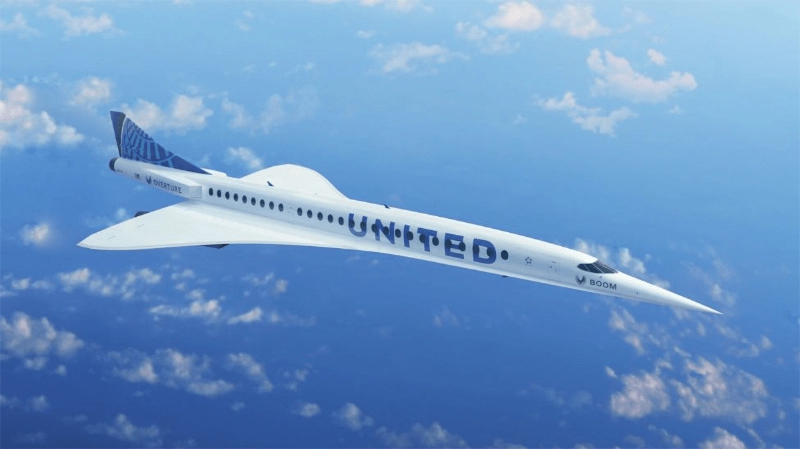
#1: Supersonic passenger jets cut flight times in half
Boom Supersonic created world’s first developed supersonic jet in 2020
Initial implementation will be supersonic travel between coastal cities, followed by supersonic travel over land (currently still prohibited)
FAA and NASA are responsible for the aircraft certification
A rendering of a United branded Boom Overture
Notes:
Example: Four and a half hours flight time from Tokyo to Seattle

Slide 7
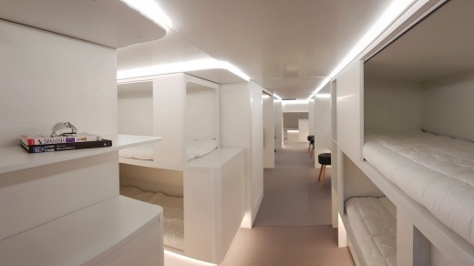
#2: Long haul aircrafts equipped with bunk beds
Qantas examines whether to equip ultra-long haul aircrafts with bund beds, gyms and children‘s play areas
Melbourne and Sydney could be connected to London and New York non-stop
Quickly occurring Economy of Scales are expected, since existing aircrafts are modified
A bunk-bed concept that Airbus developed
Notes:
Discussion: What would you prefer? Speed (supersonic aircrafts) or comfort (aircrafts with bund beds)?

Slide 8
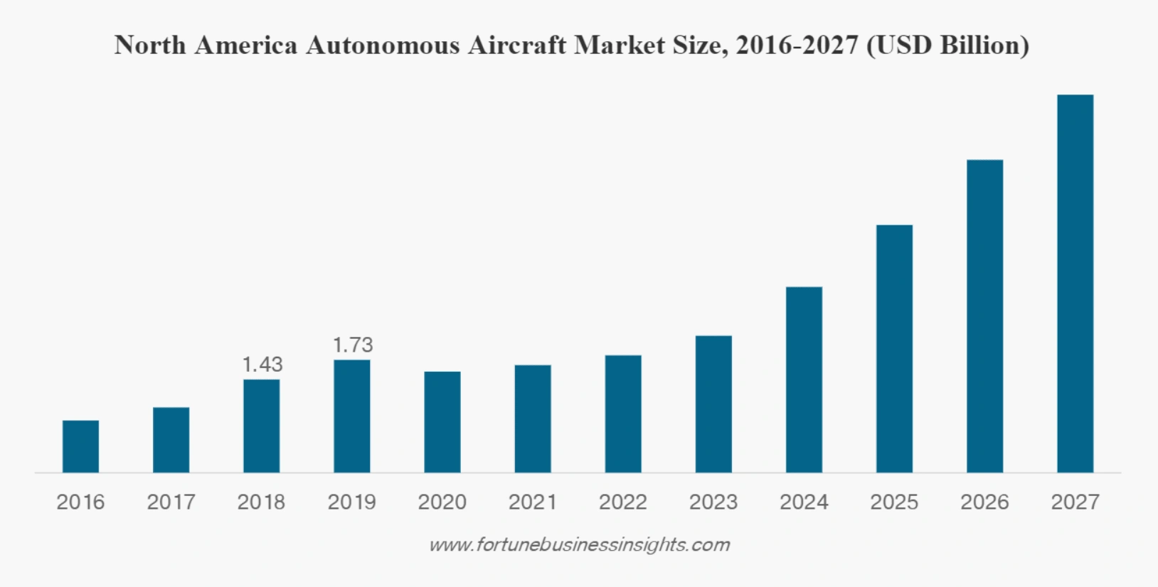
#3: Autonomous aircrafts revolutionize cargo delivery
Autopilot technology will be complemented by autonomous aircraft software
Airbus has demonstrated take off and landing without any human input
Experts forecast that the market will grow by eight times over the next six years
Source: www.explodingtopics.com/blog/airline-industry-trends

Slide 9
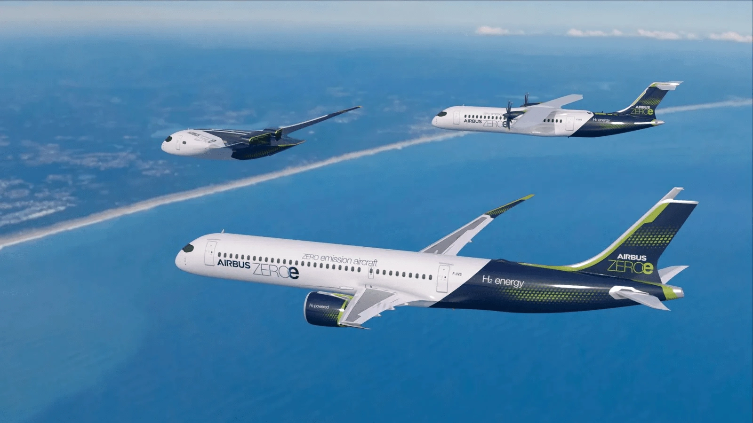
#4.1: Airlines lower carbon emissions of air travel - Sustainable fuel -
Airbus committed to launch the first carbon-neutral commercial aircraft in 2035 by creating three classes of commercial jets that run on hydrogen
Only waste that hydrogen puts off is water
Storage of hydrogen is a challenge
Airbus’s three-plane concept for its ZEROe initiative

Slide 10
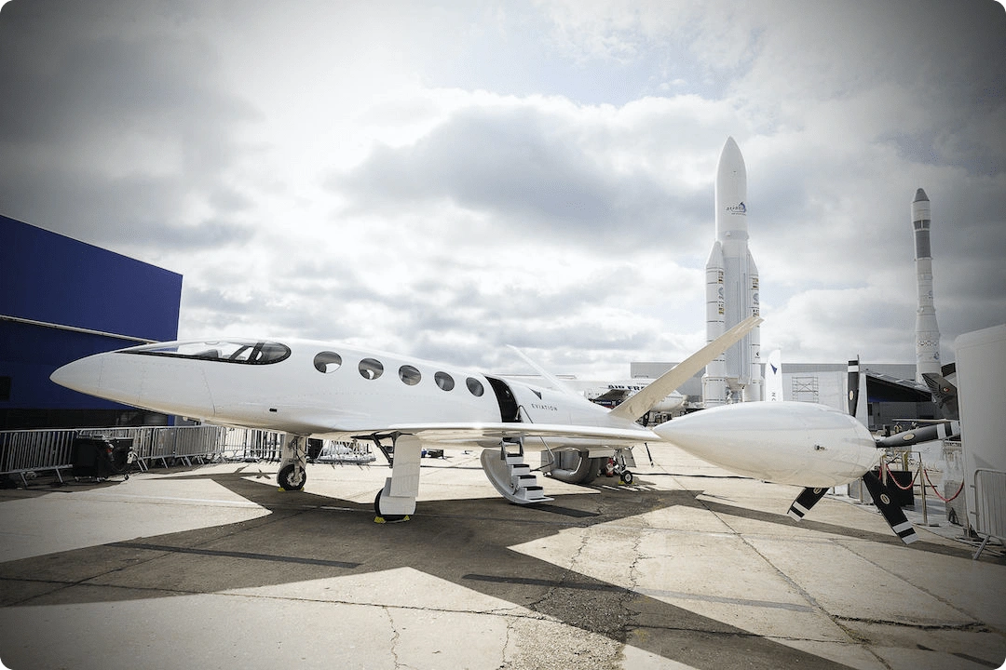
#4.2: Airlines lower carbon emissions of air travel - Electric aircrafts -
Three industries are impacted: aircraft manufacturers, commercial airlines, taxi industry
There are two main types: fixed-wing airplanes and eVTOLs (electric vertical take-off and landing)
Electric aircrafts tend to be smaller and are designed for short flights between cities
Eviation’s electric commuter plane, the Alice
Notes:
Discussion: Would you make use of urban air mobility (taking an eVTOL in a metropole rather than the taxi)? How much are you willing to spend?

Slide 11
Transportation
+++ four examples +++

Slide 12
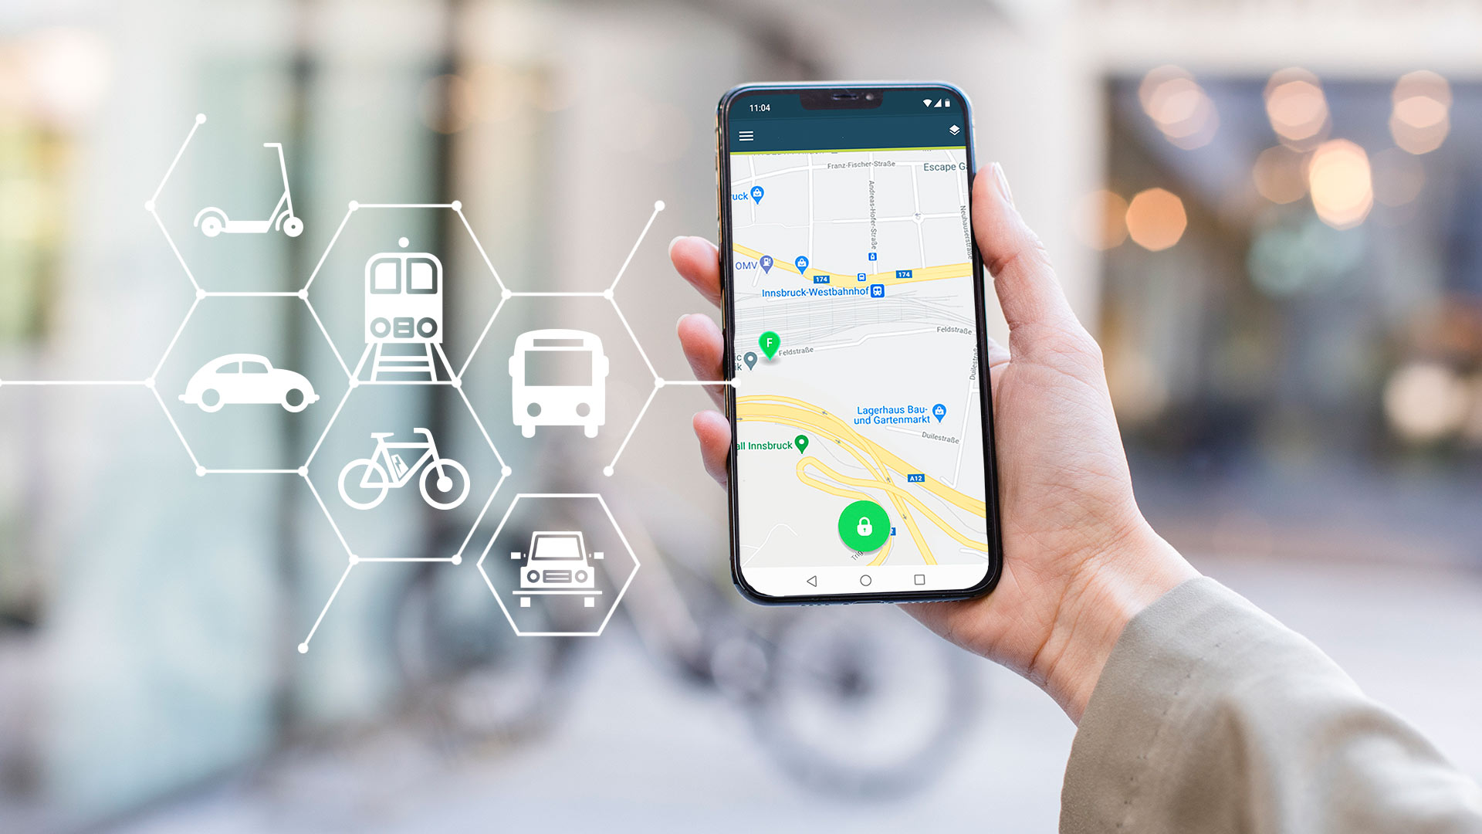
#1: Integrated transportation - seamless customer journey -
Mobility as a Service (MaaS) integrates multimodal transportation into a single mobility service
One platform provides information and payment for the traveller
Flexible and data-driven transportation can mitigate traffic congestions (significant due to rising urbanization)
MaaS bundles various transport services in one app

Slide 13
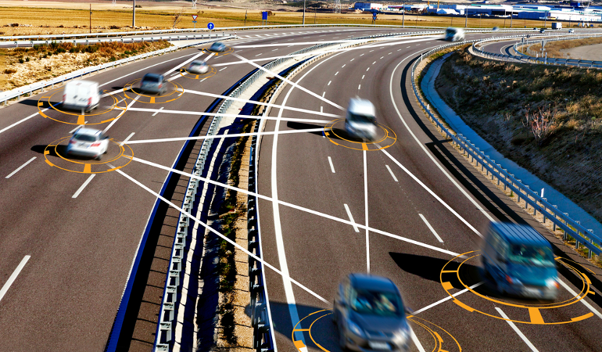
#2: Technology improves transportation efficiency
Data-based communication between trucks saves fuel costs and prevents traffic congestions
Trucks are equipped with Internet of Things (IoT) sensors monitoring the condition, stability and location of the cargo
Big data and AI are used to forecast traffic bottlenecks
Vehicle-to-Vehicle (V2V) communication

Slide 14
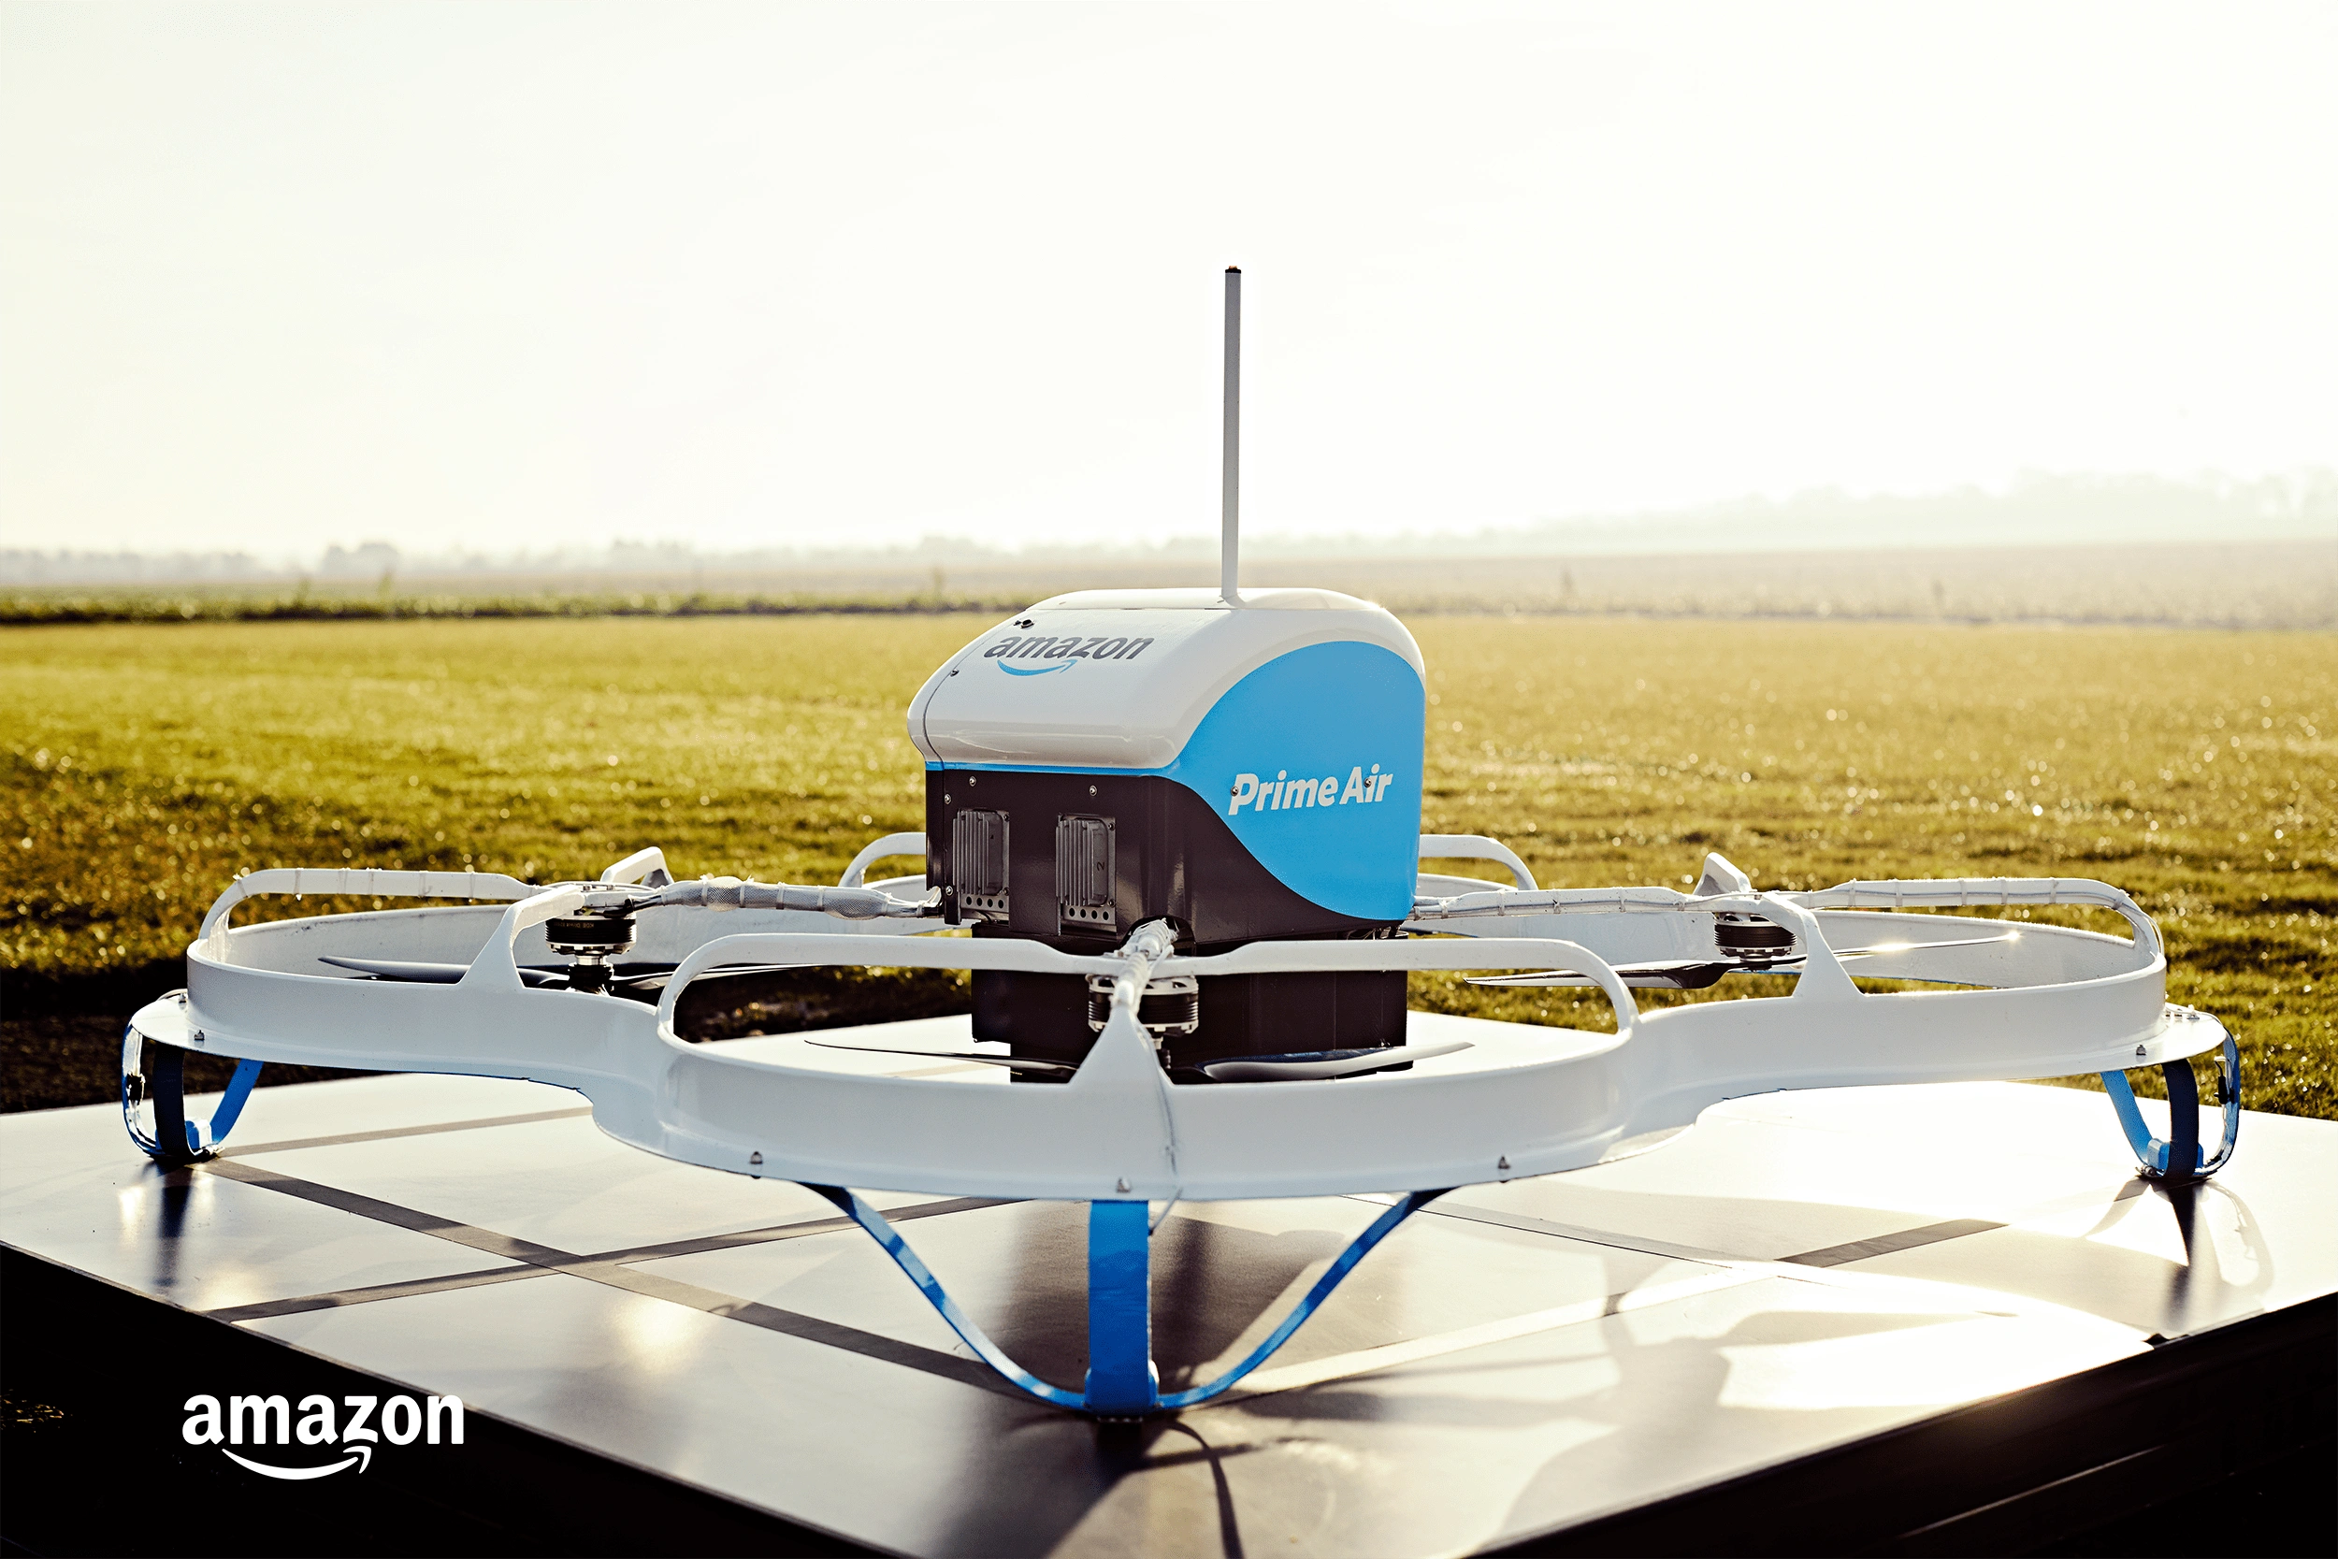
#3: Last-mile delivery efficiency increases
Even after the pandemic, e-commerce will continue to remain elevated
Final mile of a good’s transport represents 53% of the cost of transportation
Autonomous vehicles and crowdsourcing* reduce the cost of last-mile deliveries
* Transportation service is operated by several providers
Amazon’s Prime Air drone

Slide 15
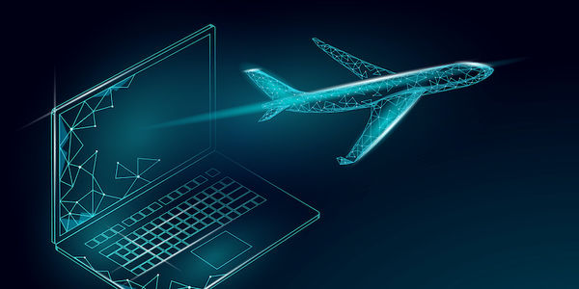
#4: Predictive maintenance saves transportation costs
Vehicles and aircrafts are equipped with sensors which produce real-time data
Maintenance issues are diagnosed and treated before they happen
Congestions and accidents caused by maintenance issues are prevented
Costs can be saved
The health status of the aircraft is transmitted in real-time

Slide 16
Travel & Hospitality
+++ four examples +++

Slide 17
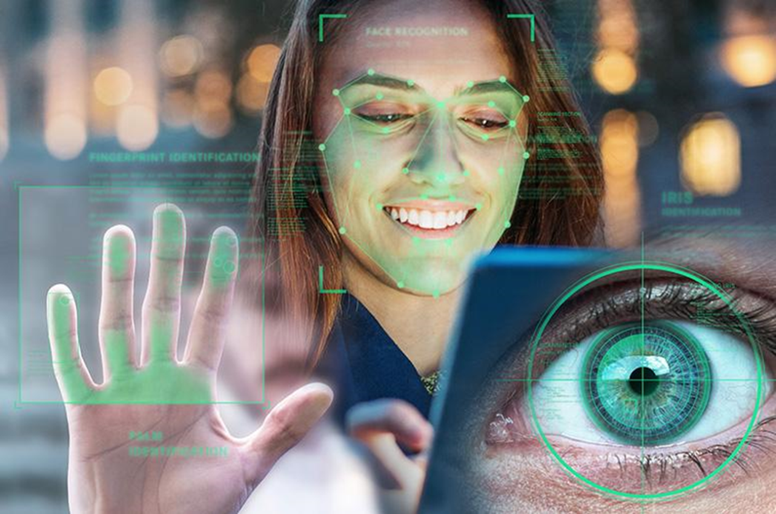
#1: The travel experience goes contactless
Biometrics such as face recognition accelerate the airport processes
Hotels offer contactless check-in
Digital room keys work via Bluetooth
Chatbots provide travellers with useful information during every stage of their journey (e.g. trip recommendations)
Biometric technologies work with fingerprints and iris scan
Notes:
Discussion: With the use of chatbots, professions like hotel concierges will partly be redundant – in general, which changes occur in the labor market due to the rising use of technology?

Slide 18
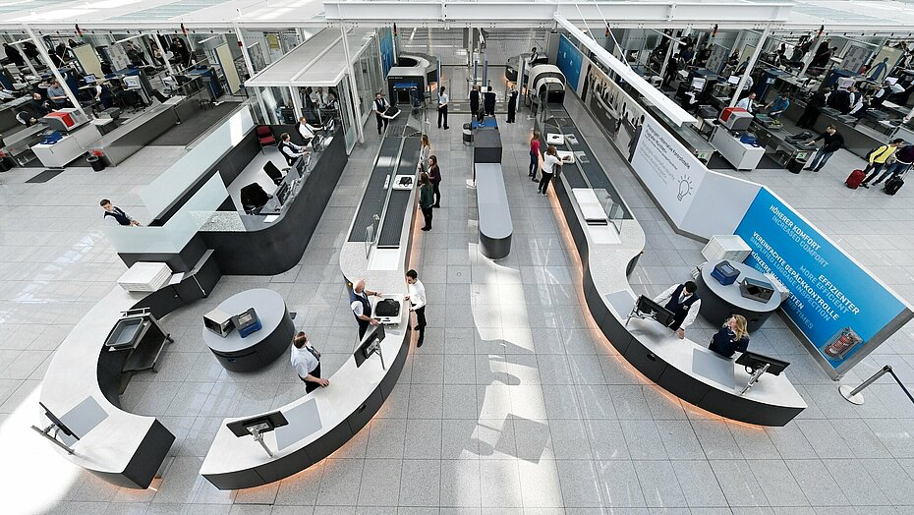
#2: Innovative technic at security - faster and more comfortable process -
At Munich Airport, the security check is equipped with Computer Tomography Scanners
A 3D scan of the luggage allows to keep electronic devices and liquids in the luggage
Throughput per hour has increased by 160%
Security check at Munich Airport

Slide 19
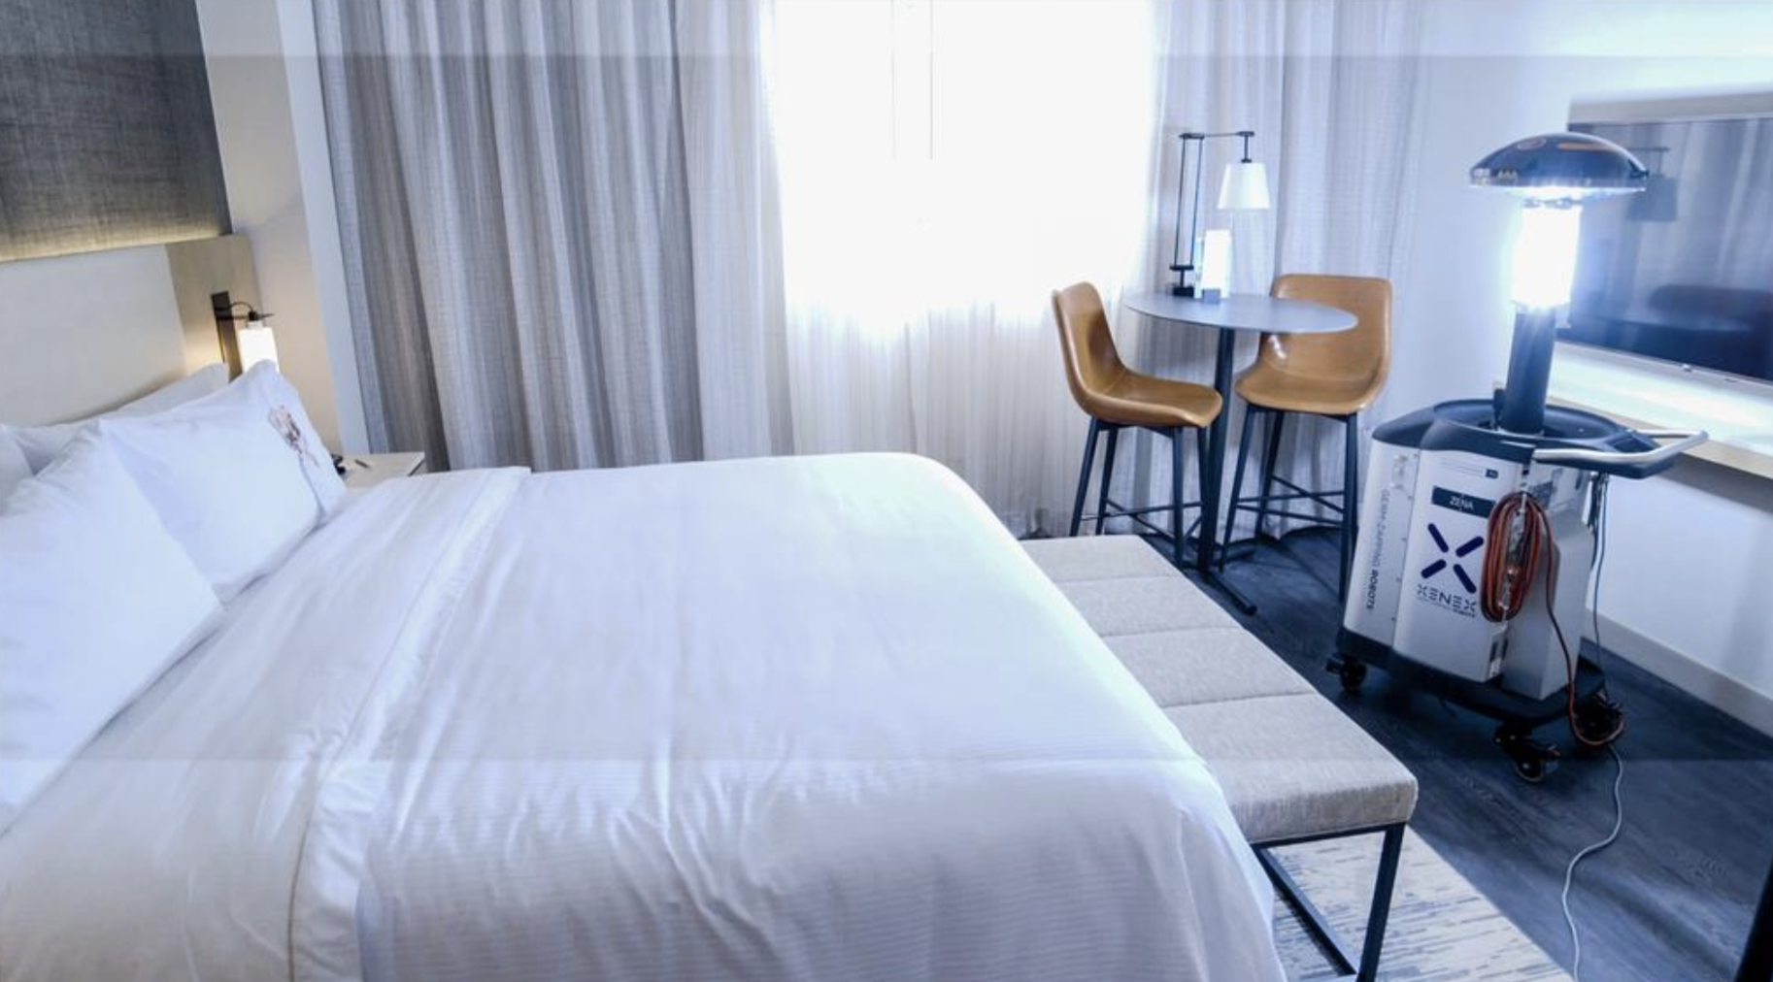
#3: Robots give hotel rooms a hospital-level cleaning
Travelers expect high hygiene standards beyond the COVID-19 pandemic
In hotels, robots clean rooms and spaces autonomously and at hospital-level
Technology is based on UV light
The cleaning process is faster with the use of robots which allows quicker room turns
Xenex LightStrike Germ-Zapping Robot cleans a hotel room

Slide 20
#4: Consumers blend business and leisure travel
Since the pandemic, location-independency has become more popular
For travellers who like to work remotely, hotels offer daytime-only room rentals and coworking spaces were added (e.g. international hotel chain Accor)
Cruise lines offer special discounts for passengers who like to work from ship (e.g. Norwegian cruise line Hurtigruten)
Caribbean island Aruba promotes a ”Workation”
Notes:
Discussion: Do you think “workation“ will be a sustainable trend?
Trend der Individualisierung aufnehmen, promotion auf neue Reisegruppe ausgelegt (Kundenzentralisierung)

Slide 21
Work hard, play hard
For you, dear cohort:
Fachbereich 3 Wirtschaft und Recht

Slide 22
Food for thought
https://www.iata.org/en/iata-repository/publications/economic-reports/air-passenger-monthly-analysis/
https://explodingtopics.com/blog/airline-industry-trends
https://www.traveller.com.au/qantas-project-sunrise-plane-plans-for-bunk-beds-gym-ditched-for-ultralong-haul-h1f0vr
https://explodingtopics.com/blog/travel-industry-trends
https://explodingtopics.com/blog/hospitality-trends
https://explodingtopics.com/blog/transportation-industry-trends
https://www.bayern.de/moderne-sicherheitskontrollen-am-flughafen-muenchen/
https://www.lufthansagroup.com/de/newsroom/meldungen/muenchen-bietet-stressfreie-sicherheitskontrolle.html

